Slide 1
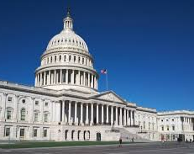
The Legislative Branch Project
Name:
Course Title:
Date:
Instructor:

Slide 2
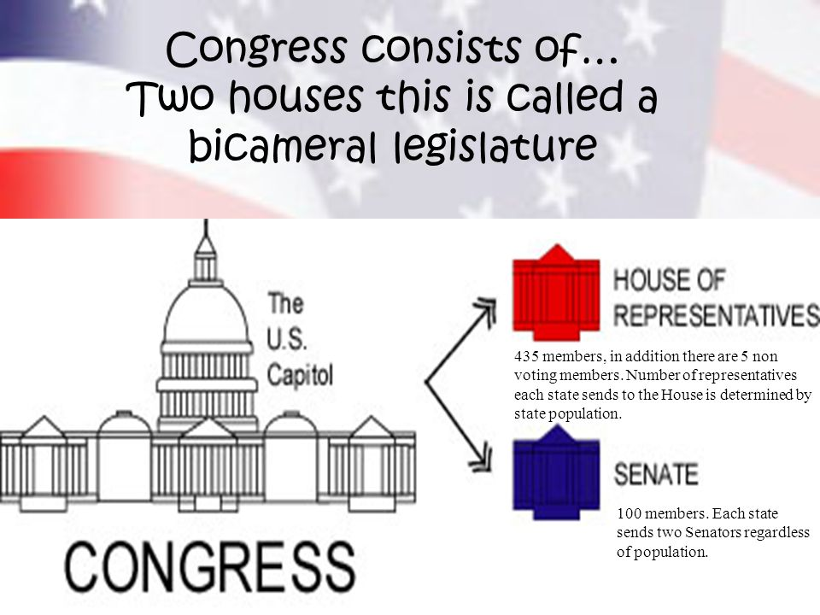
Introduction
The constitution of the US (Article 1, Section 1) allows for a bicameral system which comprises of two houses (Neal, 2020).
The upper house is the senate
The lower house is the house of representative
Both houses are referred to as the congress.
The houses are further subdivided into committees and subcommittees which serves specific purposes

Slide 3

Comparison of the two houses of Congress
Part 1:
Even though the two houses are distinct, each plays a vital role in passing legislation (Manning 2017).
The two houses have equal powers when it comes to passing of bills as each house must vote on the bill in order to become a law. However, the two houses operate differently.
While the members of the house of representative are called representative or congressman/woman, the members of the senate are referred to as senators.

Slide 4
Comparison of the two houses of Congress cont..
Part 1 cont..
SENATE | HOUSE OF REPRESENTATIVE
Commonly called the upper house | Commonly referred to as the lower house
The senate has the sole power for advice and consent | The house of representative has no power of consent
The senate is responsible for the approval of cabinets | The house of representative does not approve cabinet
The senate approves treaties. | The house of representative does not approve treaties
The senate has the power to move the motion of impeachment against any leader of the government | The house of representative has no such jurisdictions
the senate is responsible for choosing the president in special circumstances when no candidate gets majority votes in the Electoral College | house of representative cannot choosing the president in any circumstances
The senate has a longer term of six years | The house of representative has shorter term of two years

Slide 5

How Members of Congress Represent Their Constituents
Part 2:
The members of the senate and the house of representative are elected through direct voting (Madison, 2018).
The congress has a total of 535 members (Madison, 2018).
-100 senators
-435 congress men/women
The house of representative has six non-voting representatives
Each member of the senate represents serves his constituents for a period of six years. The member of the congress serves for two years after which an election is held.
The representative each represents a district which is an allotted by the state depending on the population depending on the census results.
The senators are elected from the states with each having two senators regardless of their population.
Senators and the representative represent the electorates in making decision using indirect democracy

Slide 6

Analysis of Subcommittee on Rural Development and Energy
Part 3:
Committee Name: Committee on Agriculture, Nutrition, and Forestry
Subcommittee on Rural Development and Energy
According to U.S. Senate website, the chair of the committee is Roberts, Pat (KS)
Pat was selected to head the subcommittee on Rural Development and Energy due to his interest in the in the agricultural sector particularly on rural development and energy.

Slide 7
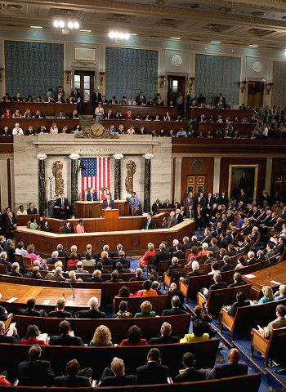
Conclusion
The congress is mandated to represent the electorates by making decisions on their behaves
They pass laws concerning the all aspects of the US
Both houses work concurrently to serve the public well
The both houses are subdivided into committees and subcommittees with members and leaders selected based on their interests.

Slide 8

We can conclude by saying that all the threats are interconnected to one another and should therefore be solved based on their priorities.
Thank You

Slide 9

References
Madison, J. (2018). The Constitution Of The United States Of America: the constitution of the united states pocket size: the constitution. JA.
Manning, J. E. (2017). Membership of the 115th Congress: A profile.
Neal, Z. P. (2020). A sign of the times? Weak and strong polarization in the US Congress, 1973–2016. Social Networks, 60, 103-112.
U.S. Senate: Committee on agriculture, nutrition, and forestry. (2020, September 19). U.S. Senate. https://www.senate.gov/general/committee_membership/committee_memberships_SSAF.htm#SSAF17

